Slide 1
Phishing Awareness Training
This training will teach you how to identify and avoid phishing attacks. You'll learn about different types of phishing, social engineering tactics, and how to protect yourself.

Slide 2
What is Phishing?
Phishing is a type of cybercrime where attackers use deceptive tactics to trick you into giving them your personal information.
They often do this by sending you emails, texts, or social media messages that look like they're from a legitimate source. They may also create fake websites that look like real ones.

Slide 3
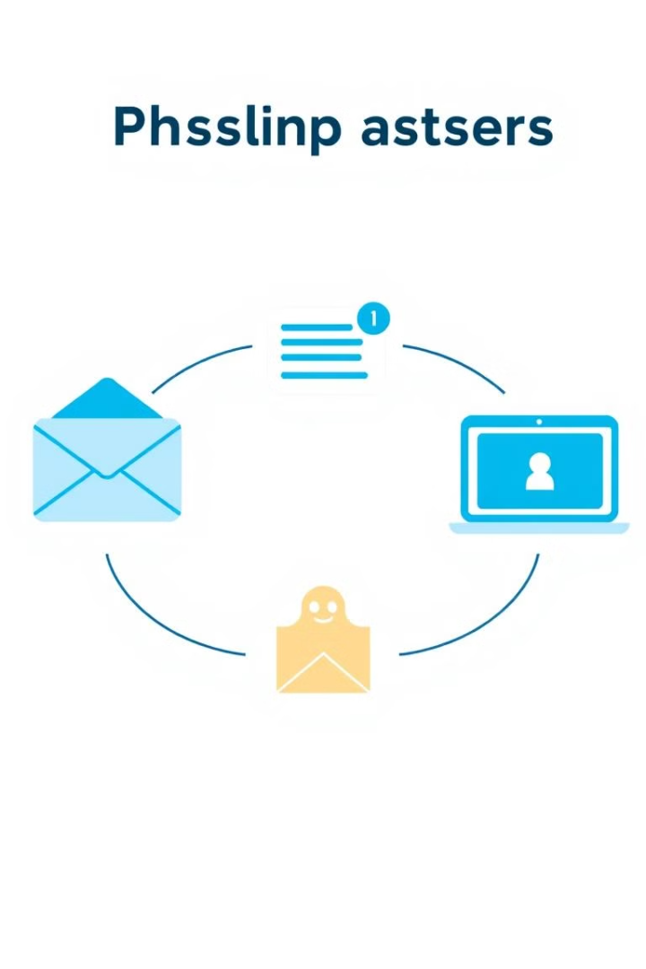
Types of Phishing
Email Phishing
Attackers send emails that look like they're from a legitimate source, like your bank or a popular online retailer.
Smishing
Attackers use text messages to lure you into clicking a link or giving away personal information.
Vishing
Attackers use phone calls to trick you into revealing sensitive information, like your bank account details or credit card number.

Slide 4
Social Engineering Tactics
Urgency
Attackers create a sense of urgency, making you feel like you need to act quickly
Fear
They may try to scare you into thinking your account is at risk, or that you're about to lose your money.
Curiosity
They may use intriguing headlines or subject lines to pique your interest.

Slide 5
How to Recognize Phishing
Suspicious Links
Hover over a link before clicking to see the actual URL, check for misspellings, and don't click on links from unknown sources.
Strange Sender
Check the sender's email address. If it doesn't match the company or organization it's claiming to be from, it could be a phishing attempt.
Poor Grammar
Phishing emails often have grammatical errors or typos.

Slide 6
Tips for Avoiding Phishing
Be cautious about clicking on links or opening attachments in emails you weren't expecting.
Always verify the sender's identity before providing any personal information or clicking on links.
Use strong passwords and change them regularly, and enable two-factor authentication whenever possible.

Slide 7
What to do if You Think You've Been Phished
Change Passwords
Change your passwords for any accounts that you think may have been compromised.
Contact Your Bank
Contact your bank or credit card company immediately to report any fraudulent activity.
Report the Phishing Attempt
Report the phishing attempt to the company or organization you think it was trying to impersonate.

Slide 8
The Importance of Phishing Awareness
Financial Loss
Phishing attacks can result in financial losses, identity theft, and even reputational damage.
Data Breach
If you click on a phishing link or open a malicious attachment, you could be exposing your computer to malware that can steal your personal information.
Phishing Link
When you click a phishing link or open a malicious attachment, you might compromise your personal data.

Slide 9
Key Takeaways and Next Steps
Stay Vigilant
Be vigilant and cautious when using the internet.
Report Suspicious Activity
If you receive an email or message that you think might be phishing, report it to the appropriate authorities.
Stay Informed
Keep up-to-date with the latest phishing scams and security threats.

Slide 10
THANK YOU

